Slide 1
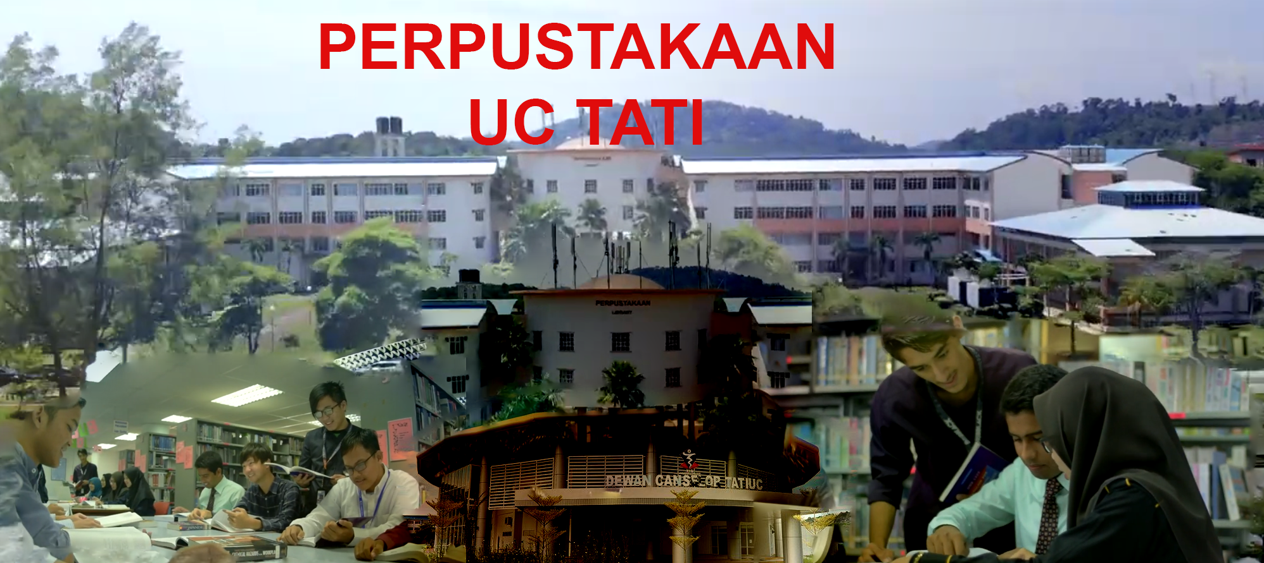
Welcome to Our Library
Empowering Learning and Knowledge

Slide 2
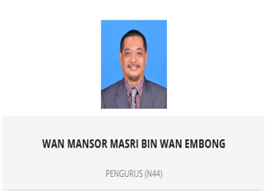
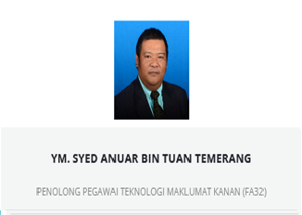
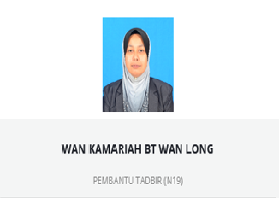
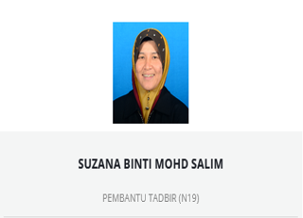
Our Staff
Tugasan:
Mengurus dan mengemaskini “website” perpustakaan
Mengurus hal-ehwal berkenaan system perpustakaan “KOHA”
Mengurus koleksi e-book (ProQuest)
Mengawal selia “Self Access Centre”
“Circulation”
“Cataloging”
Tugasan:
“Cataloging”
“Circulation”
Tugasan:
“Circulation”
“Cataloging”

Slide 3



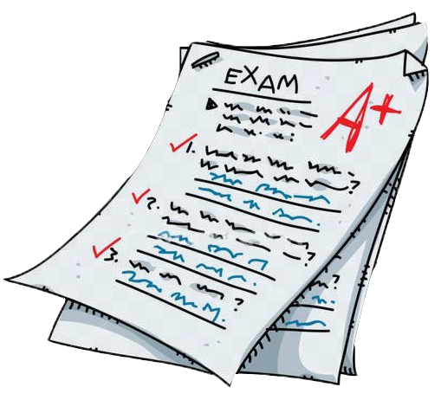







Our Services
Book Borrowing
Digital Resources
Computers Access
Study Spaces
Photostat & Printing

Slide 4


Library Statistics
Books: 18384+
Members: 1720

Slide 5
Explore Our Digital Resources
Online Journals
E-books

Slide 6



Contact Us & Hours
Opening Hours: Sun-Wed, 8:30am - 5pm
Thu, 8:30am – 3:30pm
Phone: +609 860 1421
Email: library@uctati.edu.my
Website: https://tatiuc.edu.my/libuctati

